Slide 1
Binding Energy (B.E.), Average B.E. and its variation with Mass number

Slide 2
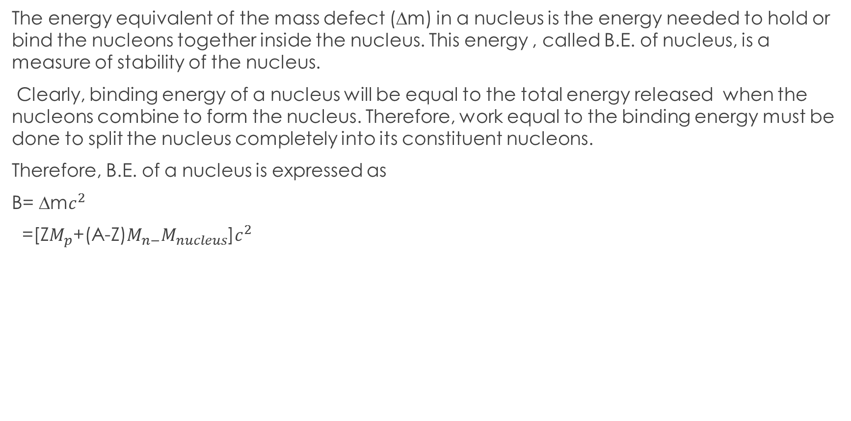
Binding Energy
The energy equivalent of the mass defect (∆m) in a nucleus is the energy needed to hold or bind the nucleons together inside the nucleus. This energy , called B.E. of nucleus, is a measure of stability of the nucleus.
Clearly, binding energy of a nucleus will be equal to the total energy released when the nucleons combine to form the nucleus. Therefore, work equal to the binding energy must be done to split the nucleus completely into its constituent nucleons.
Therefore, B.E. of a nucleus is expressed as
B= ∆m$c^{2}$
=[Z$M_{p}$+(A-Z)$M_{n−}M_{nucleus}$]$c^{2}$

Slide 3

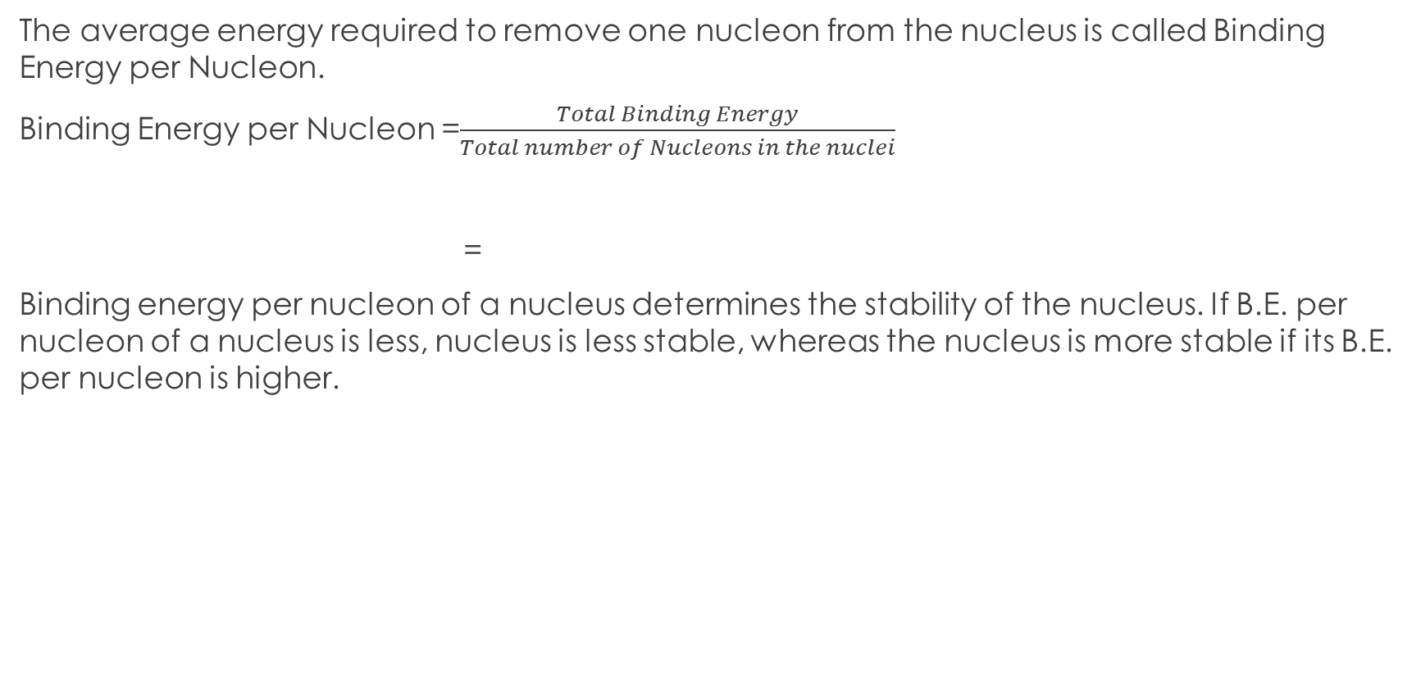
Binding Energy per Nucleon
The average energy required to remove one nucleon from the nucleus is called Binding Energy per Nucleon.
Binding Energy per Nucleon =$\frac{Total Binding Energy}{Total number of Nucleons in the nuclei}$
=
Binding energy per nucleon of a nucleus determines the stability of the nucleus. If B.E. per nucleon of a nucleus is less, nucleus is less stable, whereas the nucleus is more stable if its B.E. per nucleon is higher.
$$\frac{\text{[}\text{Z}M_{p}\text{+(}\text{A}\text{−}\text{Z}\text{)}M_{n−}M_{nucleus}\text{]}c^{2}}{A}$$

Slide 4
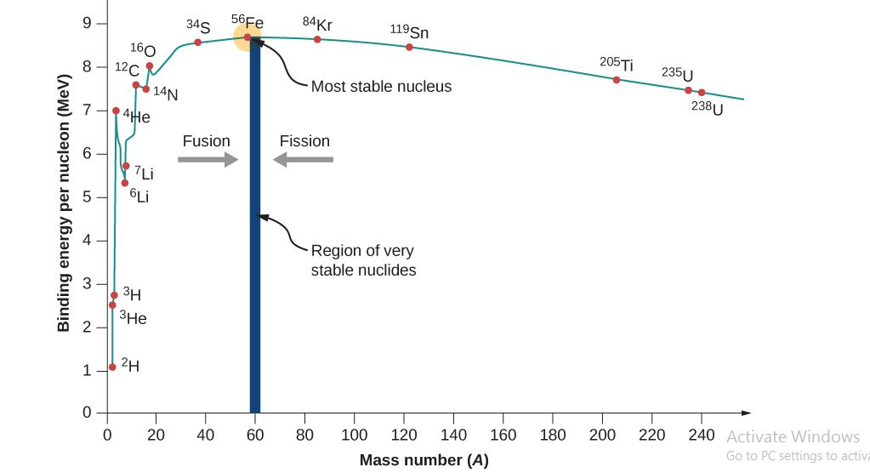
Variation of Binding Energy per Nucleon with Mass Number

Slide 5
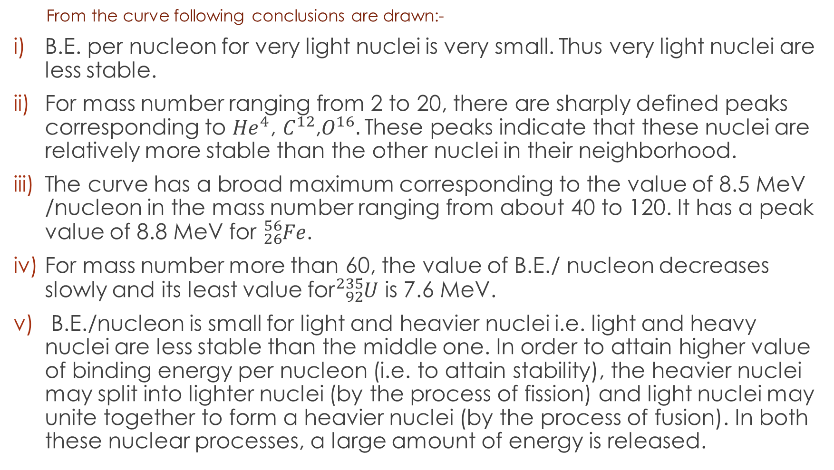
From the curve following conclusions are drawn:-
B.E. per nucleon for very light nuclei is very small. Thus very light nuclei are less stable.
For mass number ranging from 2 to 20, there are sharply defined peaks corresponding to ${He}^{4}$, $C^{12}$,$O^{16}.$These peaks indicate that these nuclei are relatively more stable than the other nuclei in their neighborhood.
The curve has a broad maximum corresponding to the value of 8.5 MeV /nucleon in the mass number ranging from about 40 to 120. It has a peak value of 8.8 MeV for ${}_{26}^{56}{Fe}$.
For mass number more than 60, the value of B.E./ nucleon decreases slowly and its least value for${}_{92}^{235}U$ is 7.6 MeV.
B.E./nucleon is small for light and heavier nuclei i.e. light and heavy nuclei are less stable than the middle one. In order to attain higher value of binding energy per nucleon (i.e. to attain stability), the heavier nuclei may split into lighter nuclei (by the process of fission) and light nuclei may unite together to form a heavier nuclei (by the process of fusion). In both these nuclear processes, a large amount of energy is released.

Slide 6
Exercise:
Q1: What is meant by binding energy and binding energy per nucleon. Explain the variation of B.E. /A with mass number A.
Q2: What do you learn of the nuclear fission and fusion from the plot of average B.E. vs mass number.
Q3: What is Binding energy? Explain the stability of nuclei on the basis of this concept.

